Slide 1



Information Communication Technology
(CSC101)
Lecture 4
Instructor: Mariam Fiaz
email: mariamsherwani434@gmail.com

Slide 2


Reference Books:
1. Computer Science Illuminated – Nell Dale & John Lewis, Jones & Bartlett Learning, LLC, 2020 (Read Chapter 10)
  2. Understanding Computers: Today and Tomorrow, Comprehensive – Deborah Morley & Charles S. Parker, Cengage Learning, 2017 (Read Chapters 5, 6, 14)

Slide 3
Contents:
  Text Codes (ASCII, BCD, Unicode)
  Computer Software
  Operating System (Purpose, Types, Functions)
  Utility Programs
  Database Concepts
  Data Hierarchy & Relationships
  DBMS (Advantages & Disadvantages)
  Data Integrity, Security & Privacy
  Centralized vs Distributed Databases

Slide 4
Text Codes:
ASCII, BCD, and Unicode are character encoding systems that allow computers to represent text, numbers, and symbols in binary form.
ASCII:
7-bit code (128 characters)
Represents letters, digits, and symbols
Example: A = 65
BCD (Binary Coded Decimal):
Each decimal digit stored using 4 binary bits
Used in calculators and digital displays
Example: 59 → 0101 1001

Slide 5
Text Codes:
Unicode:
Universal encoding system for all languages
Supports thousands of characters
Used in modern software and the internet
Extends ASCII
Example: English, Arabic, Chinese characters supported

Slide 6
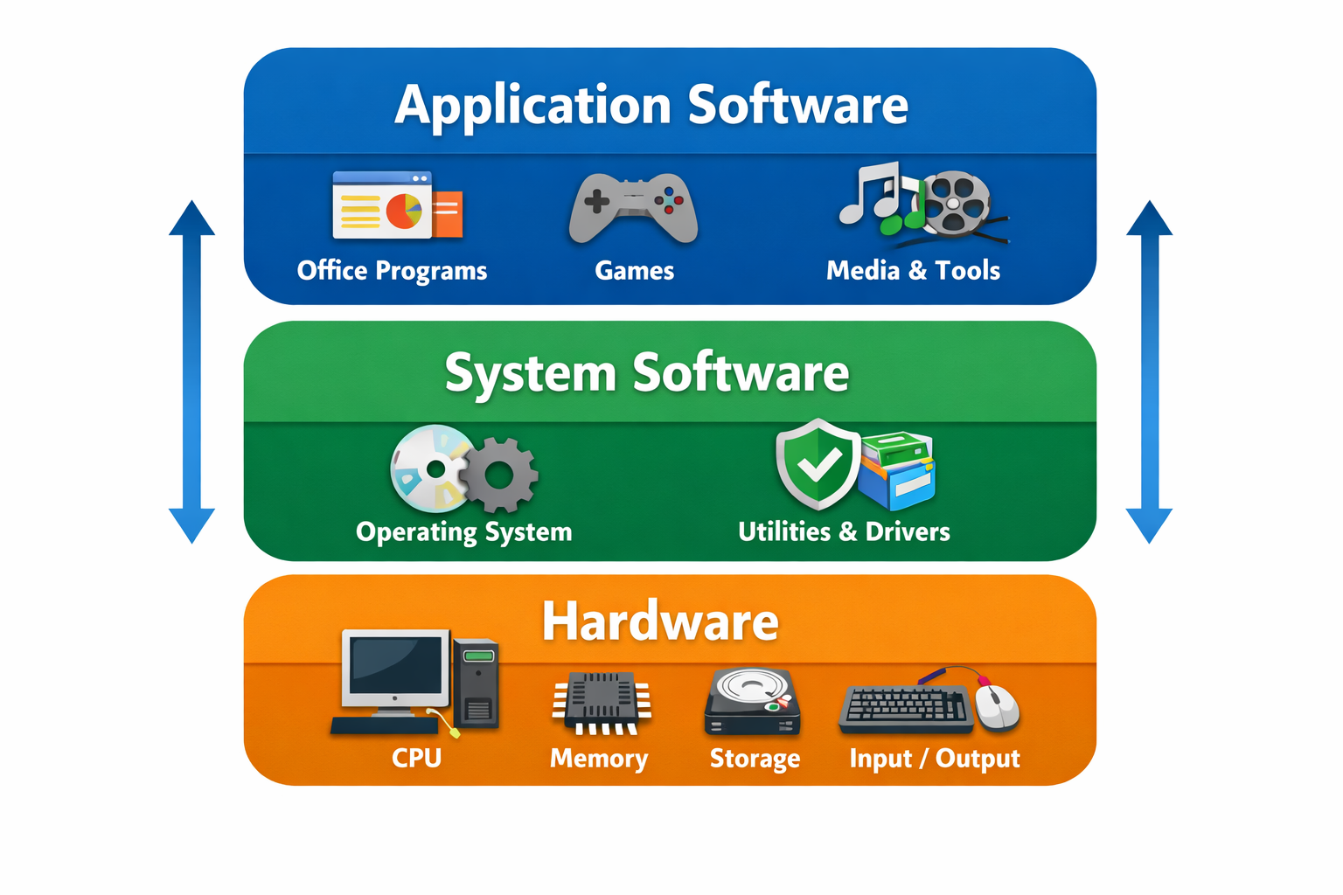
Computer Software:
Basic Defination
Software is the set of instructions which tells the computer what to do. There are two types of Computer.
System Software
Application Software

Slide 7
1. System Software
  Controls and manages computer hardware and provides a platform for application software.
  Examples:
  Operating systems
  Utility programs
  Device drivers
  Key Purpose:
  Run the computer
  Manage hardware
  Provide environment for applications

Slide 8
2. Application Software
  Programs designed to help users perform specific tasks.
  Examples:
  Word processors
  Spreadsheets
  Web browsers
  Media players

Slide 9
Operating System:
Basic Purpose of Operating System
An operating system is the main program that:
Controls hardware
Runs applications
Provides user interface
Manages system resources
It acts as a bridge between user and hardware.

Slide 10
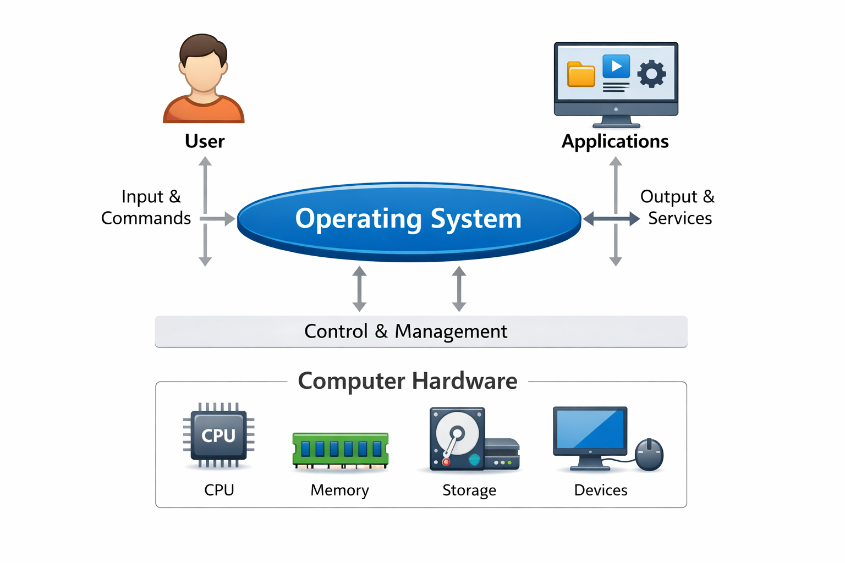

Slide 11
Types of Operating System
  1. PC Operating System
  PC stands for “Personal Computer”. Designed for single-user computers.
  Examples:
  Windows
  macOS
  Linux
  Characteristics:
  User-friendly interface
  Multitasking
  Supports peripherals

Slide 12
Types of Operating System
  2. Networking Operating System
  Controls and manages network resources.
  Functions:
  User account management
  File sharing
  Printer sharing
  Security control

Slide 13
Types of Operating System
  3. Embedded Operating System
  Built into devices to control specific functions.
  Examples:
  Smart TVs
  Cars
  ATMs
  Washing machines
  Characteristics:
  Specialized
  Limited resources
  Real-time operation

Slide 14
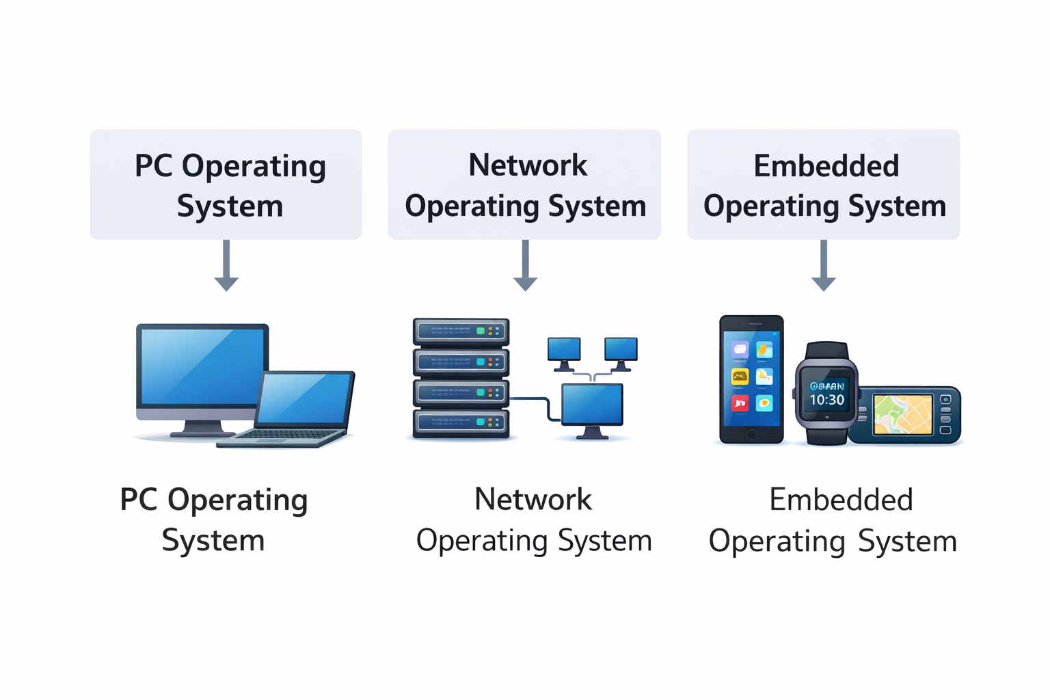

Slide 15
Operating System Functions
  1. Providing User Interface
  Ways users interact with the computer:
  Graphical User Interface (GUI)
  Command-line interface
  Touch interface
  2. Running Programs
  The OS (Operating System):
  Loads programs into memory
  Executes instructions
  Handles multitasking
  Manages processes

Slide 16
Operating System Functions
  3. Managing Hardware
  OS (Operating System) controls:
  CPU scheduling
  Memory allocation
  Input/output devices
  Storage systems

Slide 17
Utility Programs
  Utility programs help maintain and optimize system performance.
  Common utilities:
  Antivirus software
  Disk cleanup
  File compression
  Backup tools
  System monitoring
  Purpose:
  Improve performance
  Protect system
  Maintain storage

Slide 18
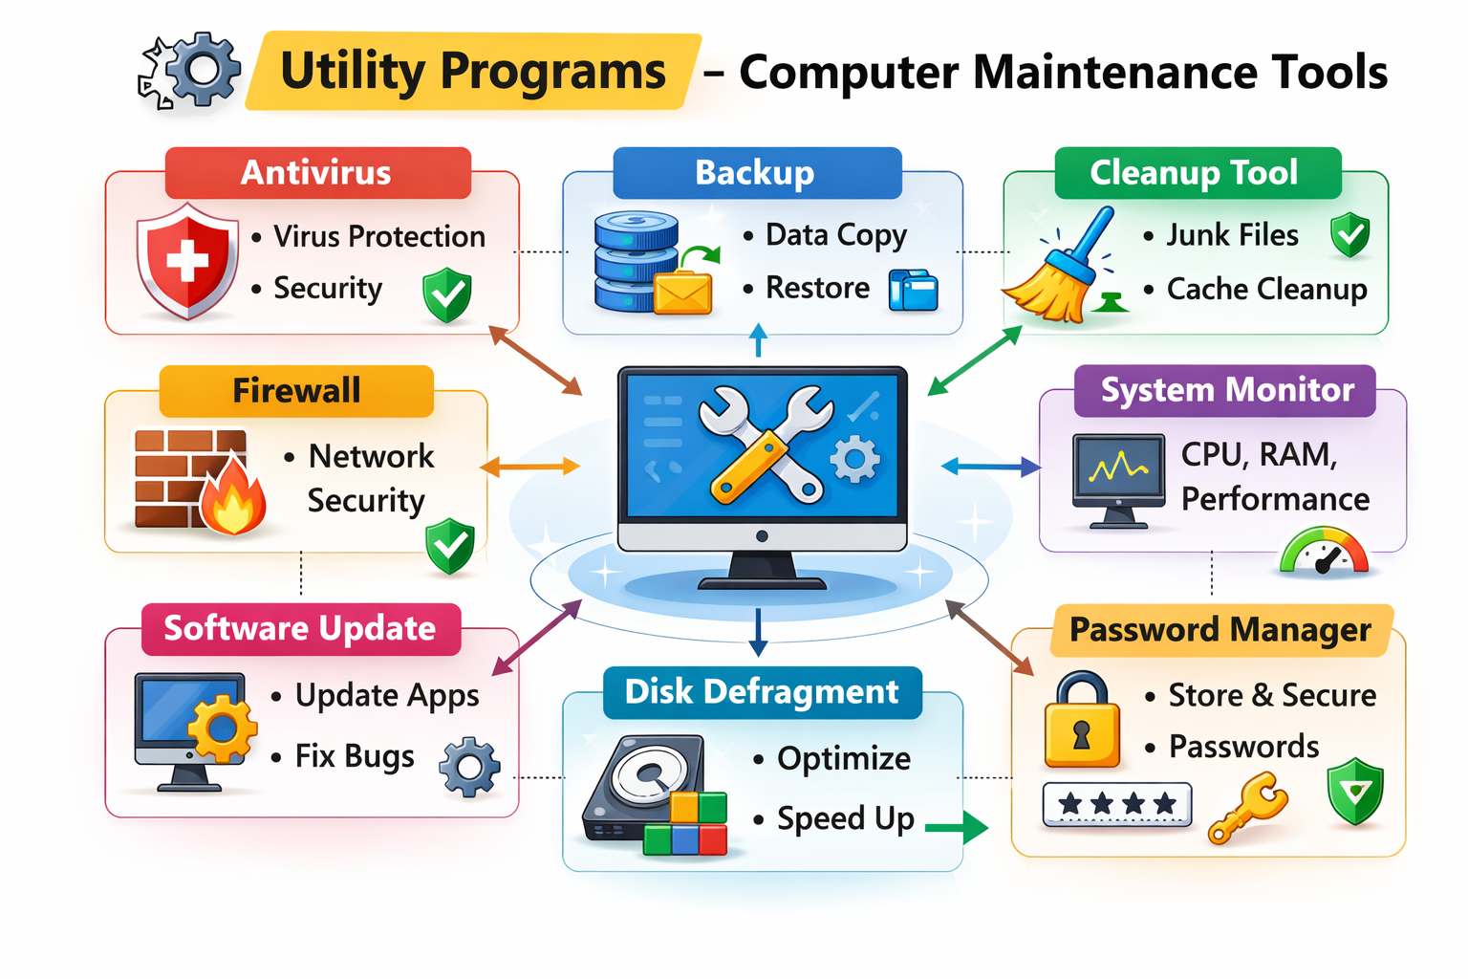

Slide 19
Database Concepts
  1. What is Database?
  A database is an organized collection of related data stored for easy access and management.
  2. Data Concepts and Characteristics
  Data = raw facts about objects or events.
  Information = processed data with meaning.
  Characteristics of good data:
  Accurate
  Relevant
  Timely
  Complete
  Organized

Slide 20
Database Concepts
  3. Data Definition
  Describes structure of data including:
  Data type
  Format
  Relationships
  Constraints

Slide 21
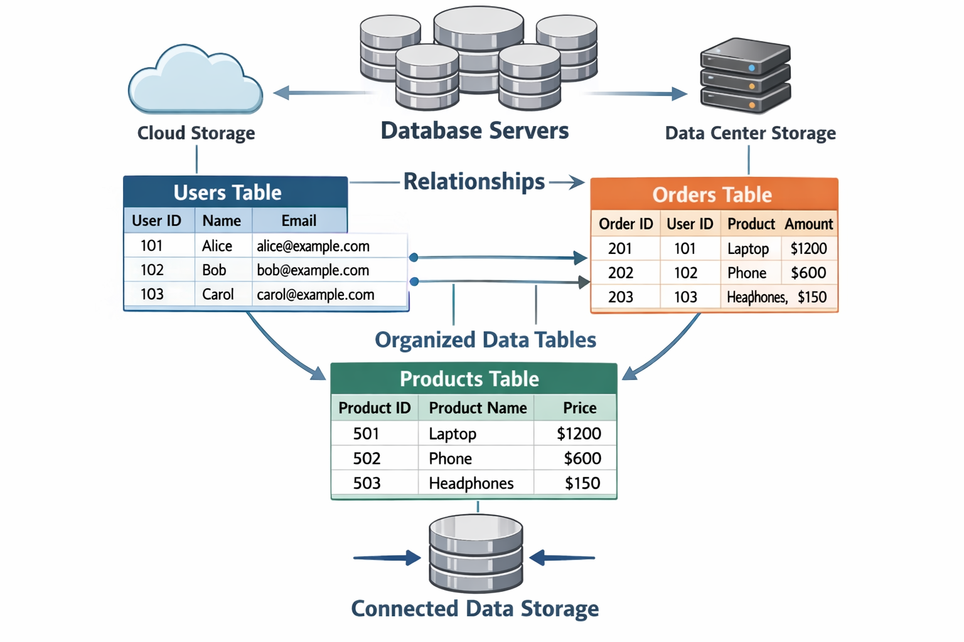

Slide 22
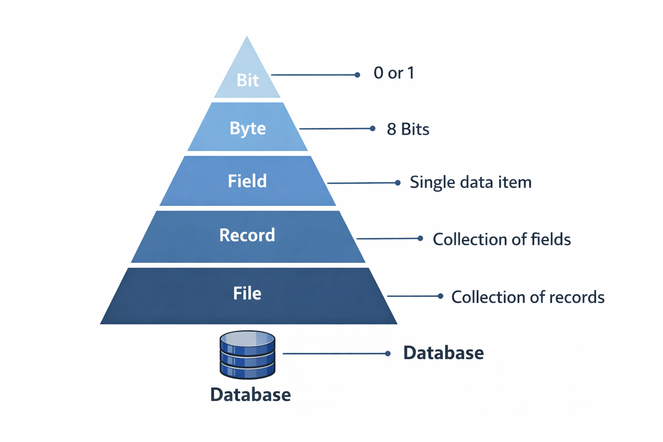
Data Hierarchy
  Order from smallest to largest:
  Bit
  Byte
  Field
  Record
  File
  Database

Slide 23
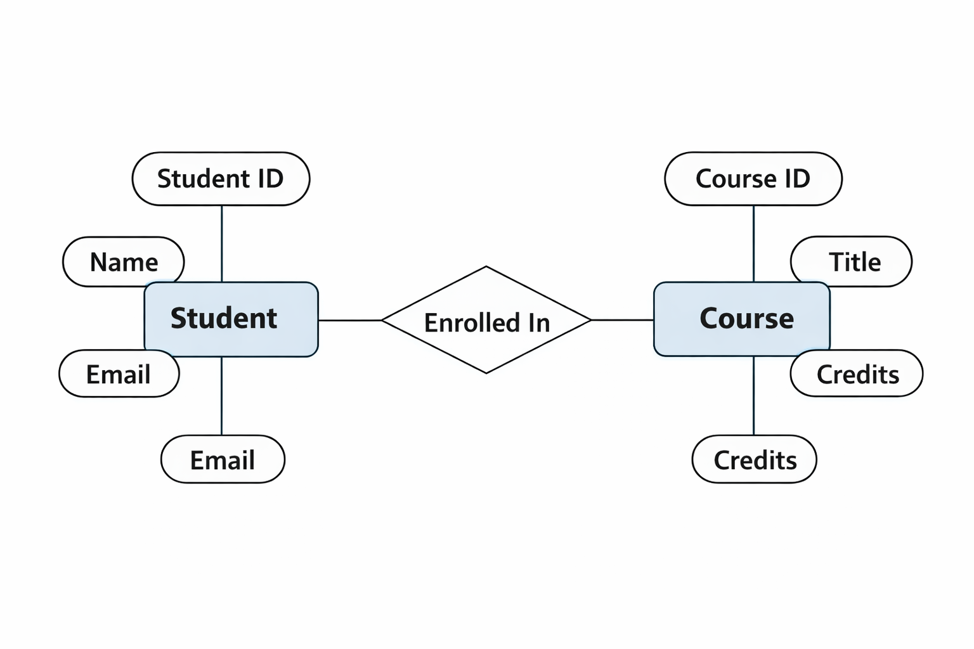
  Entities and Entity Reationship
  Entity = object about which data is stored
  Attribute = property of entity
  Relationship = association between entities
  Example:
  Student → Enrolls in → Course

Slide 24
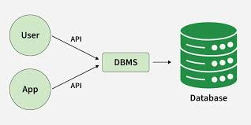
Database Management System (DBMS):
  DBMS is a software which is used to create, manage, and manipulate databases.

Slide 25
  Advantages of DBMS Approach
  Reduced data redundancy
  Improved data consistency
  Better data sharing
  Enhanced security
  Data independence
  Disadvantages of DBMS Approach
  High cost
  Complexity
  Requires training
  Performance overhead

Slide 26
Data Integrity:
  Data integrity ensures data is:
  Accurate
  Consistent
  Reliable
  Methods:
  Validation rules
  Constraints
  Backup systems

Slide 27
Security and Privacy:
  Security protects data from unauthorized access.
  Privacy protects personal information.
  Common protections:
  Authentication
  Authorization
  Encryption
  Access control
  Auditing

Slide 28
Database System Types
  1. Centeralized Database System
  All data stored in one location.
  Advantages:
  Easy management
  Strong control
  Disadvantages:
  Single point of failure
  Limited scalability

Slide 29
Database System Types
  2. Distributed Database System
  Data stored across multiple locations.
  Advantages:
  High availability
  Faster access
  Scalability
  Disadvantages:
  Complex management
  Security challenges

Slide 30
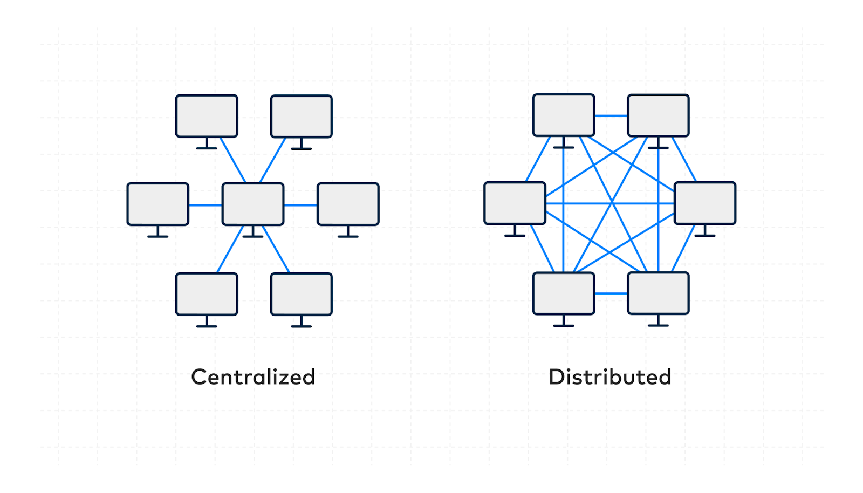

Slide 31
Summary of Lecture 3
System software runs the computer
OS manages hardware and programs
Utilities maintain system performance
Database organizes data
DBMS manages data efficiently
Data hierarchy structures information
Integrity ensures accuracy
Security protects data
Centralized = one location
Distributed = multiple locations

